Slide 1
Project Submitted By the Group:
HackerGen
Names:
Dhrup Chandra Maurya
Abhishek Chaurasia
Ayush Singh

Slide 2
IDEATE TRACK

Slide 3
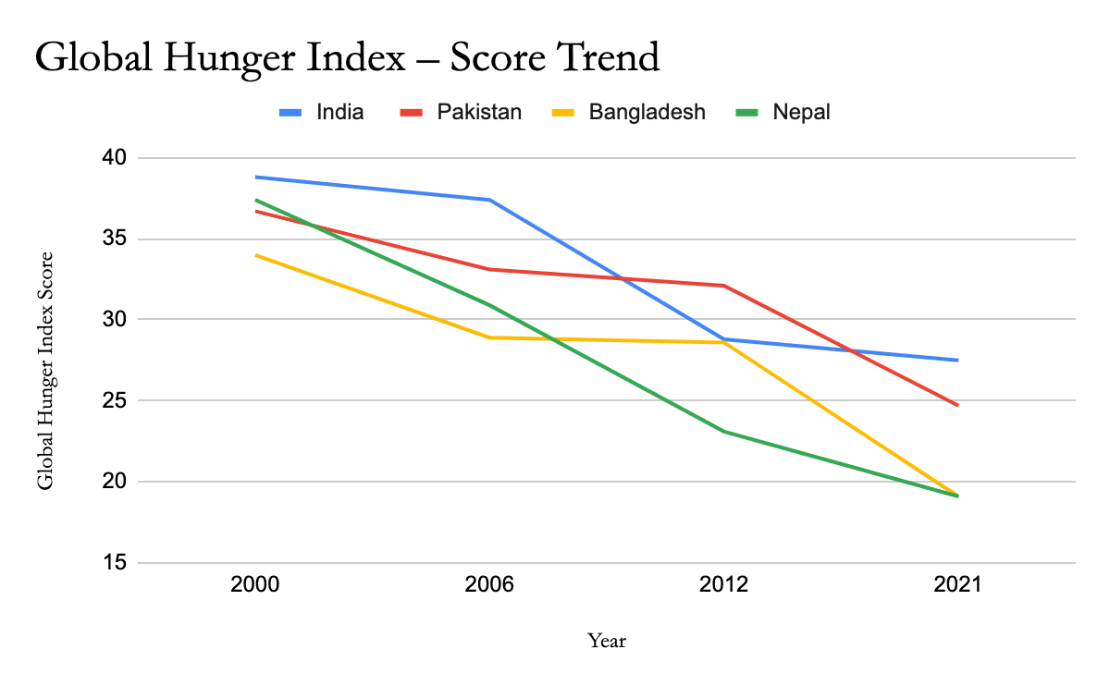
Graph taken from Internet.

Slide 4
Every night 1 out of 7 people go to bed hungry.
The above graph predicts the global hunger index out of 100 points , where 0 indicates the no hunger and 100 indicates a “Extremely alarming” situation.
The index uses four major parameters for calculating the global score.
1.Child Wasting:-Children under 5 who have low weight for their height .
2.Undernourished Population
3.Child Stunting:-Children under 5 who have low weight for their height.
4.Child Mortality:-The rate of Mortality for Children under 5.

Slide 5
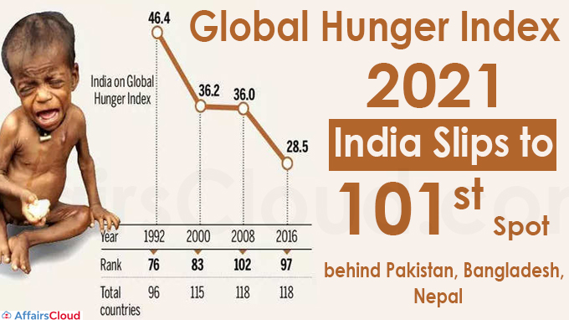
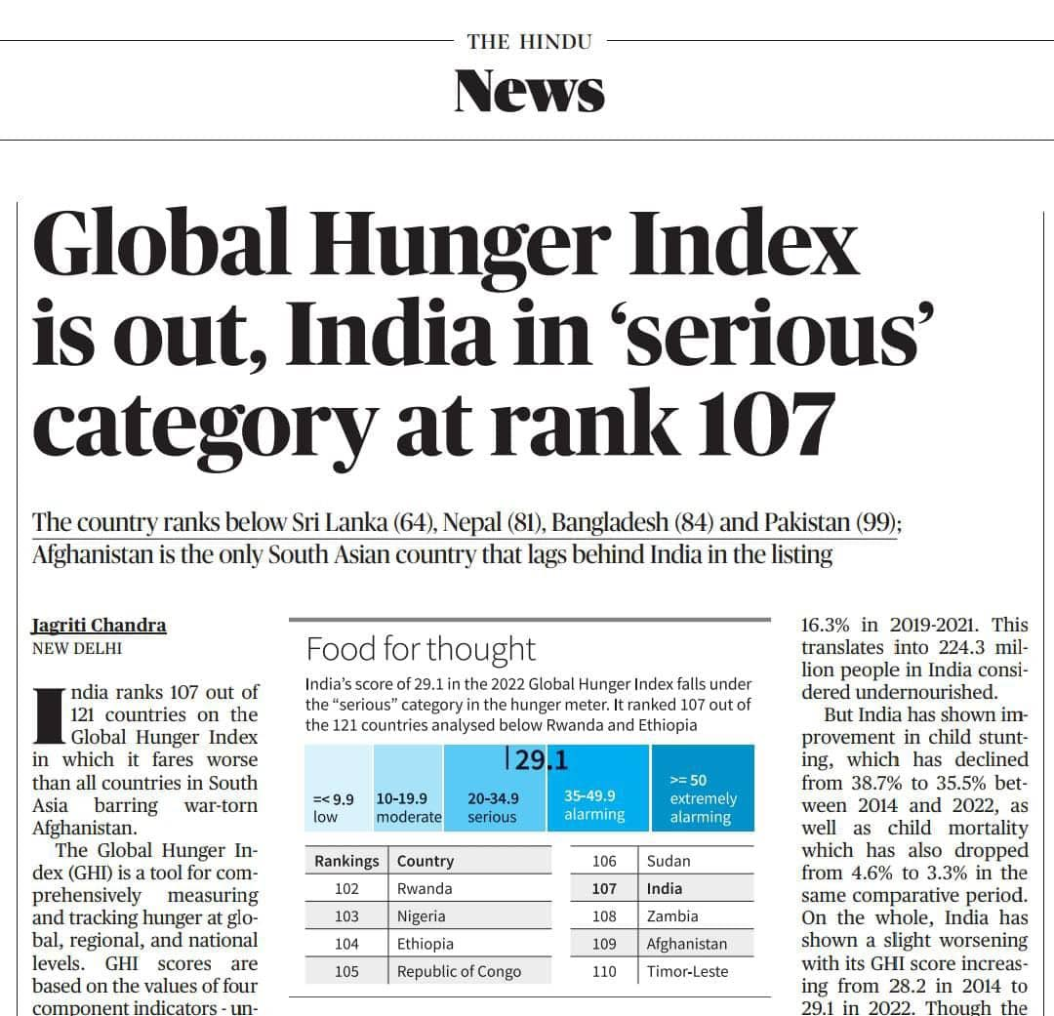
Picture taken from Internet.

Slide 6
In 2021 India was ranked 101st among 116 countries.
India’s score in Global Hunger Index is 29.1 which puts India in the category of “SERIOUS” Hunger problem.
India’s Hunger Index in 12 Years
2011 | 67
2012 | 65
2013 | 63
2014 | 55
2015 | 80
2016 | 97
2017 | 100
2018 | 103
2019 | 102
2020 | 94
2021 | 101
2022 | 107

Slide 7
According to UNEP report for 2021, India wasted as much as 50 kilos of food per person per year.
Isn’t it a sarcasm, On one side people are dying because of no food and on other side there is wastage of Food.
The reason for the food waste is Improper management and lack of Planning. Lots of food are wasted from Wedding places , restaurants, Hostel mess, Households etc.
Our Team HackerGen is providing a Solution to this problem

Slide 8
Name of Our Idea
FOODBANK
Service to The Nation

Slide 9
What we would do?
We would bring all the restaurants, Marriage Halls, Hostel Messes to a single platform , In which they would consent to give away the left over food to Food Banks. The Food Banks would pack the food hygienically and transfer the food packets to the distributors. Now, the Distributor’s responsibilities is to reach to the needy people and serve the food. All these things would be controlled by our Centralised website where the details of all the volunteered Hotels, Restaurants would be given.
In India There are approximately 22 crore people who sleep hungry without food, By this method we can actually solve the problem of approximately 16 crore people.
Design and Solution of this are given in Upcoming slides.

Slide 10
Design Track

Slide 11
Food Suppliers
Food Suppliers
Food Management control system
Food Distribution
Food Bank
At location 2
Food Bank
At location 1
Food Distribution
Central control station
Food Distribution
Food Distribution
Food Bank
At location 3
Food Bank
At location 4
Food Suppliers
Food Suppliers
To be continued

Slide 12
Food Management Track
Restaurant
supplier
Food distribution
Distribution centre -1
Food Bank 1
(Food packing)
Food distribution
Hostel Mess
supplier
Distribution centre - 2
Food distribution
supplier
Distribution centre -3
Hotels,etc

Slide 13
Solution Track

Slide 14
How people would get benefit?
Most of the poor people, beggars, daily wage workers, homeless children etc. don’t have roof over their head. They spent their nights on or outside the railway station, Bus Station, Under the Breeze, Near the temples. I myself have witnessed these kinds of people and these people not only beg for money, they ask for food as well.
These people can reach out to us at our Food Banks which would be located near these stations or temples, where we would be delivering the food to them.
All the needy and hungry people can take the food from these places.

Slide 15
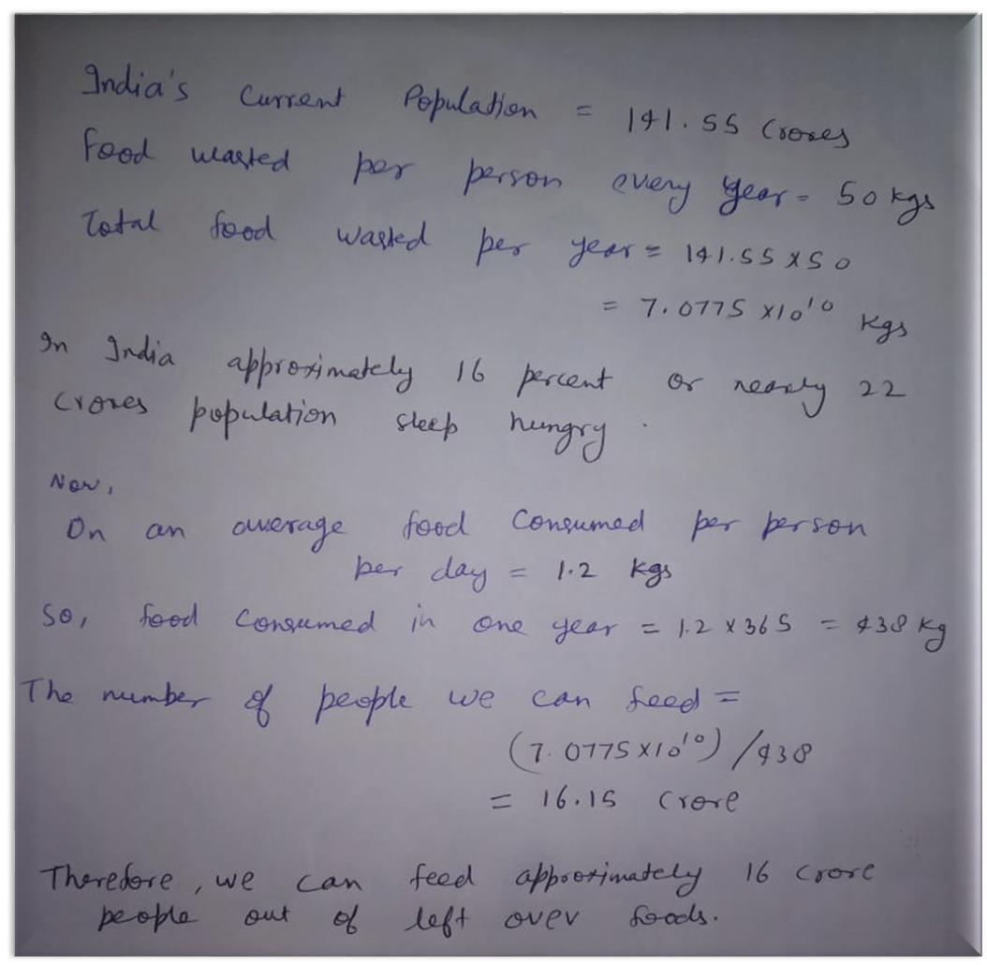
Here is a Calculation which shows approximately how many people we can feed?

Slide 16
How these Restaurants, Hostel Messes, People from homes etc. would get benefited? And Why would they agree to volunteer?
They can put their Hotel’s, Restaurant’s labels on the food packets. So it would be the advertisement of their Hotels. Therefore whatever money was supposed to be invested on advertisement, they would indirectly help poor people and their advertisement will also be done.
By doing this they would also be respected among the society and they would earn a positive feedback of people.
And furthermore people who regularly contribute to these Food Banks by giving them the left over food, we can issue a certificate or recognition to their contribution to the social Services.
These kinds of small step would create a big difference in the Society.

Slide 17
How are we going to be Benefited?
First of all this idea is not for our benefit, It is for helping the poor people and needy people. So it will be like a social service. But on a longer run when this idea would be established, we can start tiffin services taking fresh food from Our regular volunteer hotels and restaurants and delivering it to the people like Zomato and Swiggy. As we would have a positive image on the society , therefore people would mostly prefer to order food from us. And in this way we can generate revenue to run our Social Service food Bank and would try to extend our reach to the backwards villages of our country.

Slide 18
Documentation
We are hostel students and we see many kilograms of left( breakfast , lunch , dinner) food getting wasted everyday in our mess and from there we got this idea to manage such food and try to reach those people who are there in need.
We are presenting the problem and solution in this presentation.
We will make a food tracking website where all such big food producers(Restaurants ,Hostel mess , Hotels) to mention their left over food after(Breakfast ,Lunch ,Dinner) to our websites and within some minutes the nearby Food Banks will collect this food from there places and send this food for packing and this it will be send to distributors in their locality.
Distributors will place their order on our websites that how many packets of food they need in their location accordingly they can receive that from nearby Food Banks.
To be continued

Slide 19
After receiving food from suppliers the Food Banks responsibility is to pack it hygienically and transfer this packets to the distributors.
Now, Distributors will find people and try to help them so that they can survive their rest of their life.
We can do this project on large scale including many people who can pay and buy the food on daily need as they don’t want to make it or they are just living alone in their house and they can’t cook it.
We have included idea , design and solution of the given problem in this presentation.
This Project can be supported by our government and can be implemented everywhere in the country to save food and save life.

Slide 20


